Slide 1

Data Analysis on OYO Hotel Accomodations

Slide 2

About us
Name : Y.Govardhan Reddy
Qualification : B.TECH
Batch : 271
Name: D.Vijay Kumar
Qualification : B.TECH
Batch : 271
Name : K.Abhishek
Qualifaction : BSC
Batch : 273

Slide 3
Contents:
Introduction
Problem statement
Tools
Website for web-Scrapping
Raw Data
Data Cleaning and Data Manipulation
Cleaned Data
EDA
Conclusion

Slide 4
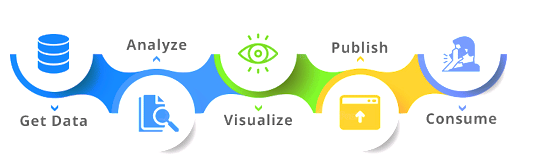
Introduction:
Problem Statement:
1. Analyzing OYO's city-wise pricing, discounts, and tax compliance to optimize strategies.
2. Analyzing discounts' impact on revenue and occupancy alongside tax compliance across
varied city landscapes.

Slide 5
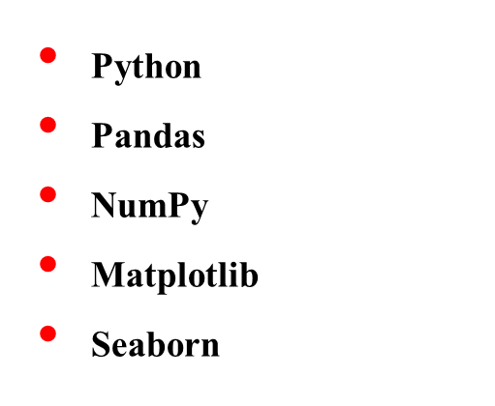






Tools (Libraries) used:

Slide 6
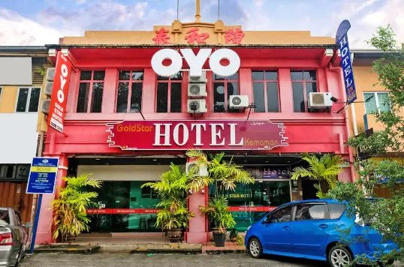
Website used for Data Analysis

Slide 7
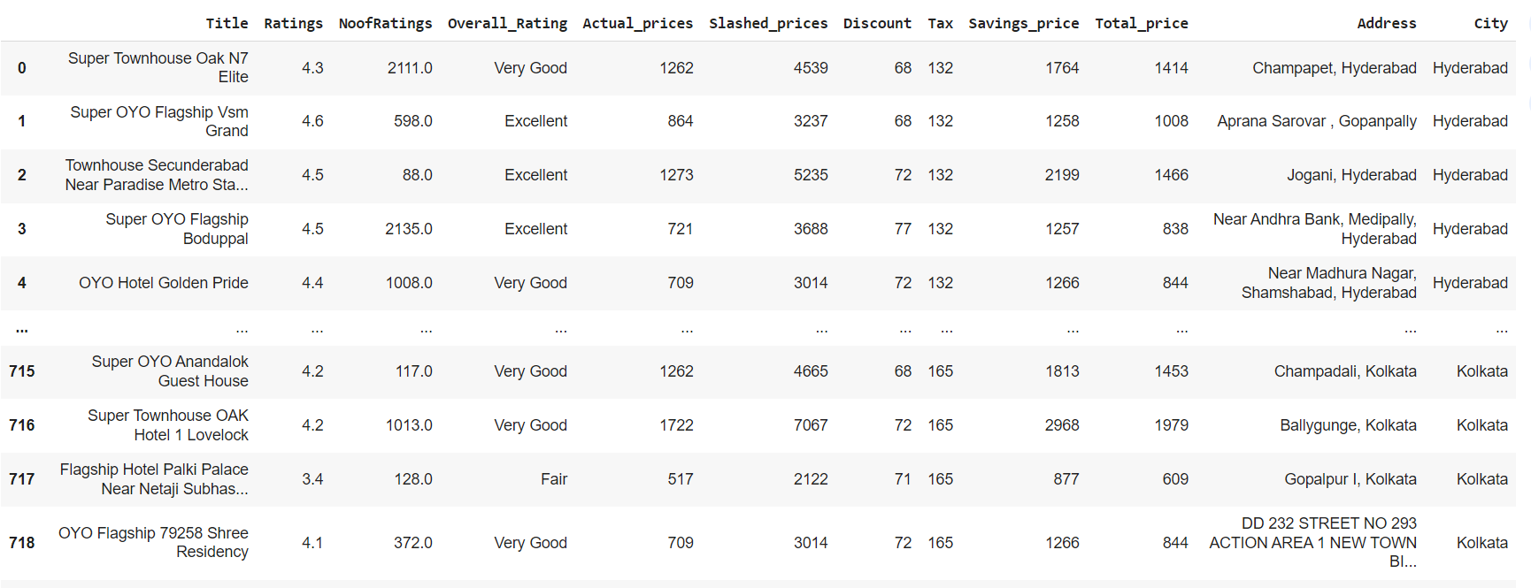
Raw data from the website

Slide 8
Data Cleaning Steps
Identify Missing Values and Handle Duplicates
Handle Missing Values:
Correct Data Types
Standardize Values
Identify and Handle Outliers
Handle Text Data:

Slide 9
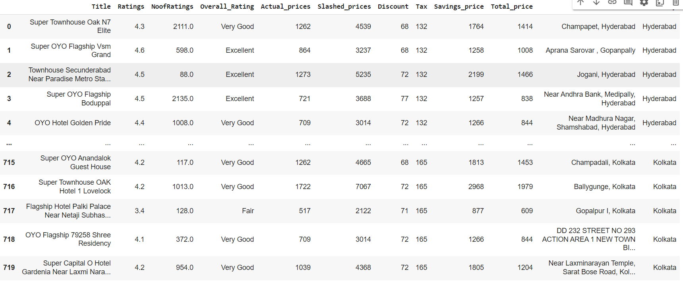
Cleaned Data Frame

Slide 10

Steps Involved In Data Analysis
Objective Definition
Data Collection
Data Cleaning
Documentation
Exploratory Data Analysis (EDA)

Slide 11
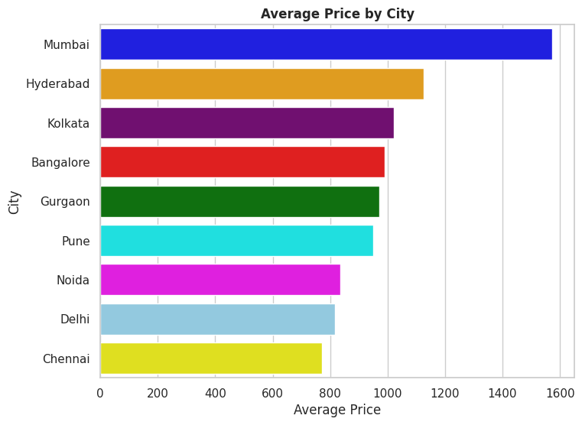

Slide 12
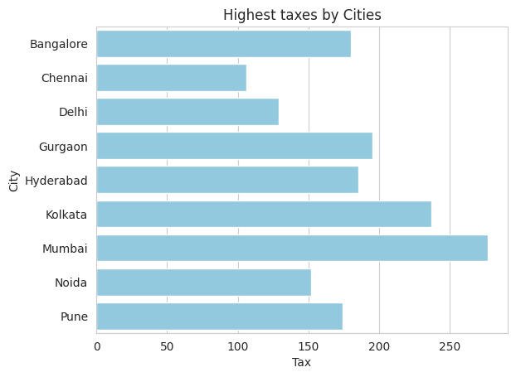
Which city has collected the Highest Taxes

Slide 13
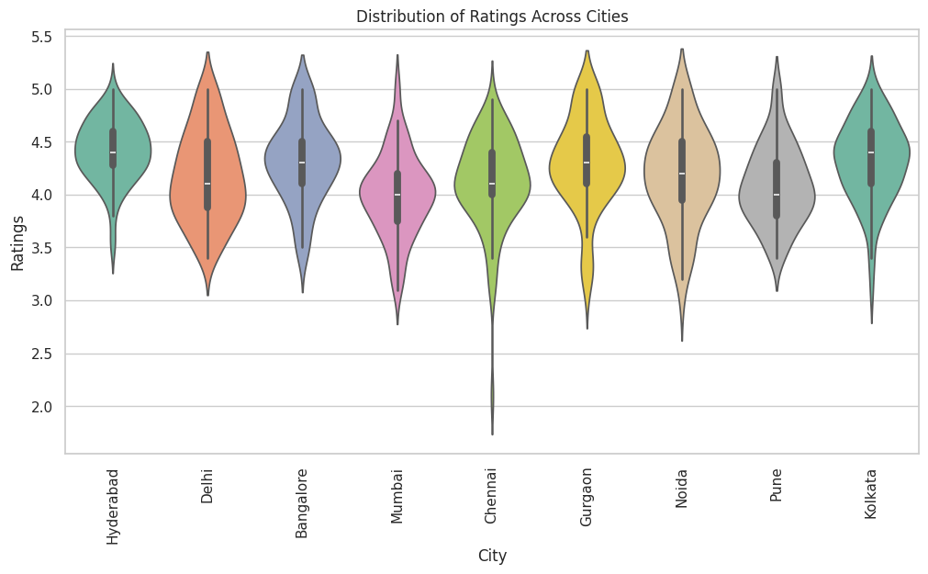
Exploring Ratings Variance Across Cities

Slide 14
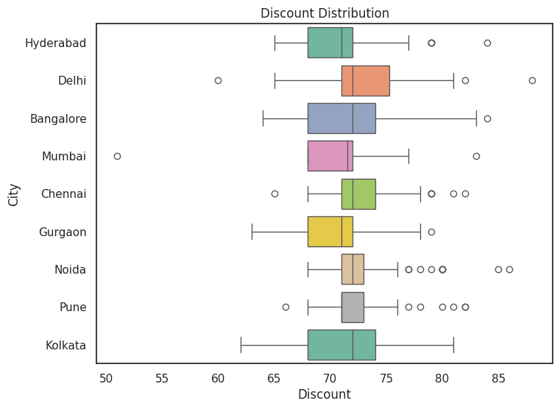
"Visualizing City-Wise Discount Distribution : Uncovering Variances in Pricing"

Slide 15
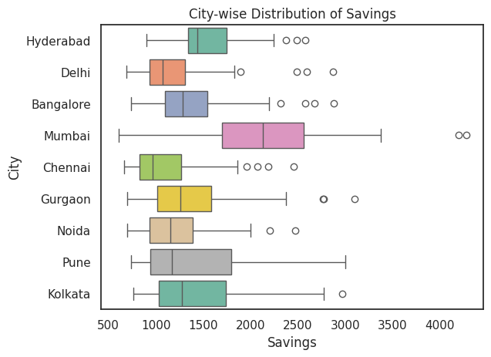
“Analyzing Savings Price Distribution Across Cities: Insights from Box Plot Analysis"

Slide 16
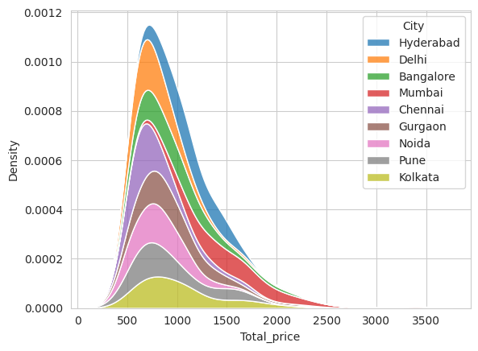
"City-wise Price Distribution: Unveiling Variations Across Locations"

Slide 17
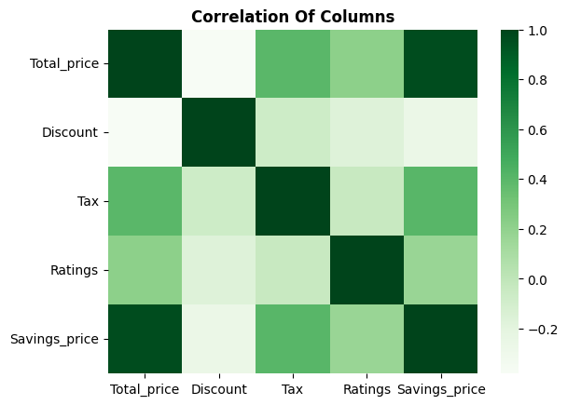
Correlation Analysis

Slide 18
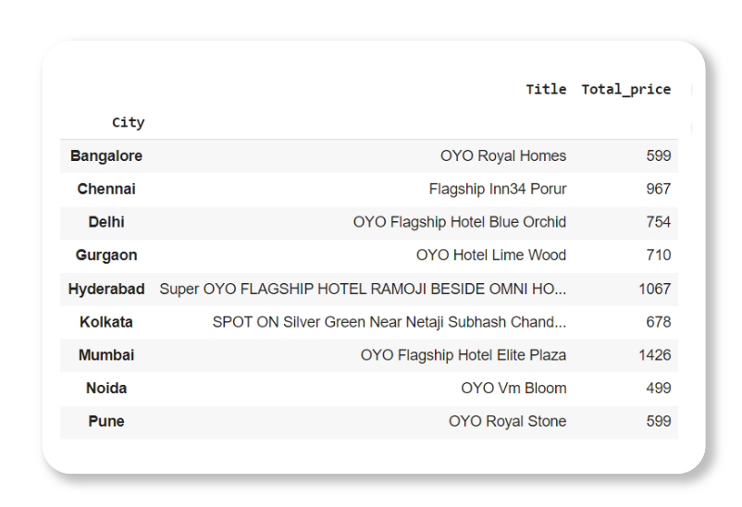
Unveiling Top-Rated Hotels with Budget-Friendly prices Across Cities

Slide 19
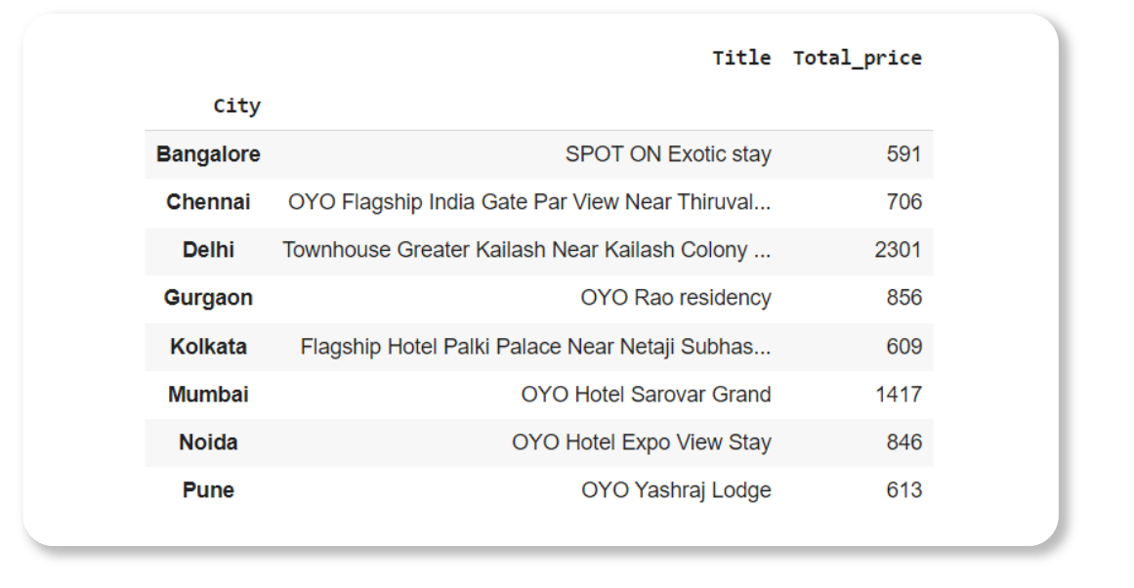
"Unveiling Low-Rated Hotels with High price Across Cities

Slide 20
Conclusion
- Mumbai has the highest average pricing, with Chennai at the lowest, while tax
compliance and pricing exhibit no significant correlation.
- Hyderabad enjoys superior ratings, indicating potential for leveraging customer
satisfaction, while Mumbai offers substantial savings to customers.
- Price distribution in Hyderabad is more centralized, contrasting with Kolkata’s
dispersed pattern, suggesting varied market dynamics across cities.
Recommendations
- Leverage Hyderabad's positive ratings to attract more customers and enhance brand reputation.
- Implement targeted discount strategies across cities to optimize revenue and occupancy.
- Ensure consistent tax compliance across all cities to maintain regulatory adherence and avoid penalties.

Slide 21

THANK YOU

